Slide 1
雲端計算
Cloud Computing
Cloud Issues and Challenges
Standard and Law

Slide 2
Agenda
Introduction
  Issues & challenges
Cloud Security
  Security & attack
Cloud Standard and Law
  Guideline for secure cloud
  Law and privacy

Slide 3
Cloud Standard and Law

Slide 4
Outline
Introduction
  Why we need a security standard and obey the law
  Business, risk and money
Cloud Security Alliance (CSA)
  Governance and operation
Law and Privacy
  Which one is important
Summary

Slide 5
Security
A lot of cloud service are provided by many companies
  Storage, web hosting, business model …etc.
  Dropbox, Amazon EC2 and Salesforce.
  Cloud computing is full range of services.
Also, these are many traditional and cloud security issues
  How can we go smoothly?

Slide 6
Security Issue
Cloud computing is the subset of computer services
  It also has the same problems of traditional security issue.
    Hardware, software and management attacks.
Cloud computing has other particular problem
  Under the concept of on-demand service, users share all of the resources.
    Incomplete isolation technique would increase the security risk.

Slide 7
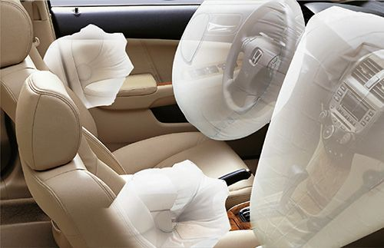
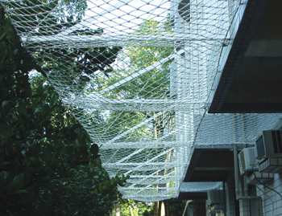

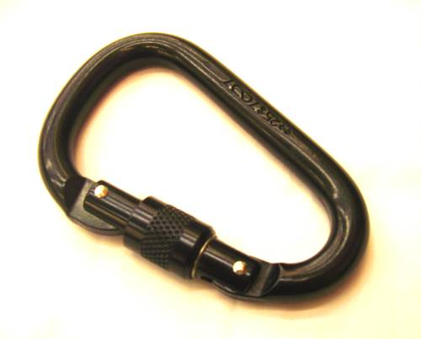
Risk
In addition to the security issue, users also concern the security risk
  How about the security management?
  How about the incident response and remediation?

Slide 8
Why so Serious?
In companies, each time of security problem means an economic loss
  Stopping service one hour not only stops making money but also loss the customers.
  Company’s reputation is the most important part.
How can we find the best solution?
  Where is the security guideline?

Slide 9
Back to the Cloud
In recent years, cloud computing is popular and lots of companies want to join into this industry
  Every company want to be the leader.
  Every company want to design the standard.
View to the security , there are lots of the cyber security standard
  ISO 27002
  NIST
  RFC 2196
There is the cloud security standards?

Slide 10
Cloud Security Alliance

Slide 11
Standard
Cloud security alliance (CSA) is a not-for-profit organization
  Try to promote the use of best practices for providing security assurance within Cloud Computing.
  Provide education on the uses of Cloud Computing.
CSA provides general views of cloud computing, security issue which may be encountered and some security suggestion
  User can use the cloud control matrix to build a secure cloud environment

Slide 12
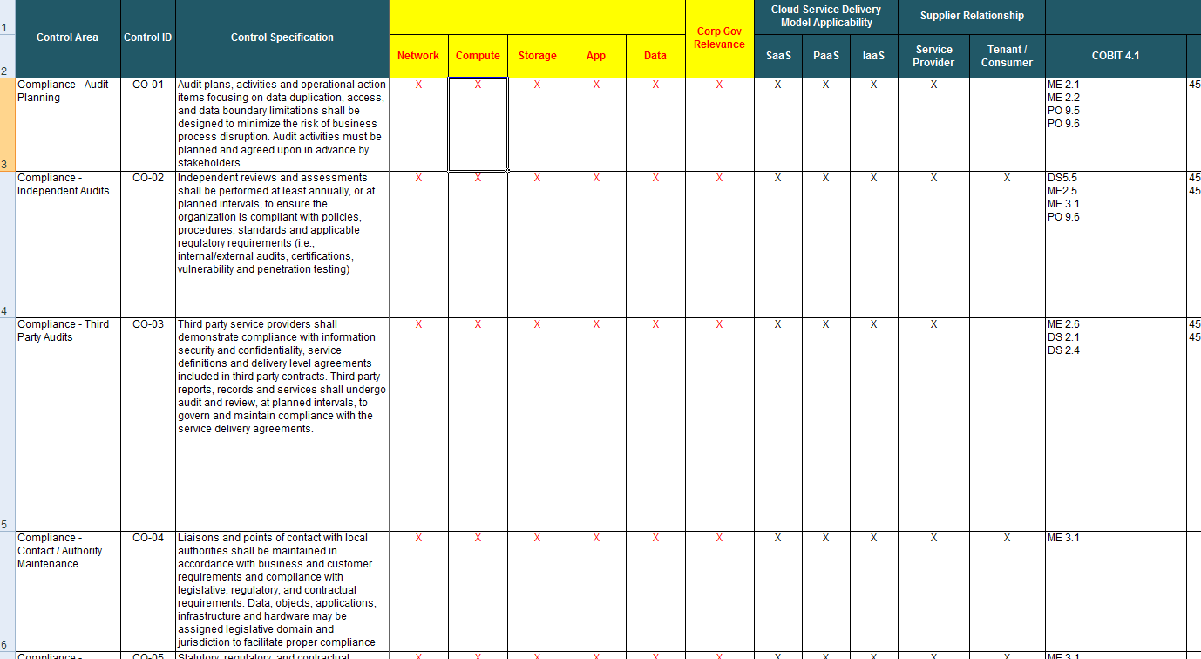
Security Matrix

Slide 13
Cloud Control Field
CSA separates cloud computing into two fields which has total 12 subprojects:
  Governance
  Operation
Cloud governance introduce how to build a secure cloud service
  Cloud company build a secure environment.
  How does the cloud customer choose a secure platform.
Cloud operation introduce how to solve security problem and maintain a secure cloud environment.

Slide 14
Cloud Control Field (cont’d)
Risk Management
Legal and electronic discovery
Compliance and audit
ILM
Portability and interoperability
Governance
CSA Guidelines
Disaster recovery
Data center operation
Incident response
Application security
Encryption and key management
Access management
Virtualization
Operation

Slide 15
Before Join in Cloud
CSA provides five steps
  How to choose a suitable cloud platform
Requirement
Asset
Deploy Model
Service
Model
Data Flow and Logic

Slide 16
Before Join in Cloud (cont’d)
Step 1: understand your requirement
  CSA classify the usage of cloud into two classes: data and application.
  Depended on your usage, understand which one is running on your cloud platform.
Step 2: assess your assets
  Depended on the important of data and application, you should provide difference level of security protection.

Slide 17
Before Join in Cloud (cont’d)
Step 3: choose the deploy model
  Depended on your secure requirement, different deploy model has difference default protection properties.
  Private cloud in internal environment has highest default protection.
Step 4: choose the cloud service model and vendor
  SaaS has the lower responsibility and IaaS need to rebuild the security mechanism by yourself.
Step 5: understand the data flow and program logic
  Designed a reasonable and effective secure cloud service requires company full understand the workflow of service and possible threats.

Slide 18
Prepared
After five steps, companies and customers can both select the cloud platform which meets the requirement
  But there are many security issue need to be concerned.
Combined with the full understand of requirement and classify the assert, cloud users could design the suitable secure environment.
  Build the service environment or platform.
  Operate the service.
  Keep the service quality.

Slide 19
Cloud Security Alliance
Governance
Operation

Slide 20
Governance
Governance and enterprise risk management
Legal and electronic discovery
Compliance and audit
Information Lifecycle Management
Portability and interoperability

Slide 21
Governance
In cloud computing, companies provide many services to users and customers use services what they need
  How to reduce the security risk when using cloud computing?
The security risk in cloud computing include
  Any kind of emergency.
  Audit and law problem.
  Migration between two cloud vendor.
  …etc.
Governance is a guideline when choosing a suitable cloud vendor and service model.

Slide 22
Governance (cont’d)
In governance field, CSA proposed five class which need to be concerned and CSA given some suggestions
  Governance and enterprise risk management
  Legal and electronic discovery
  Compliance and audit
  Information lifecycle management
  Portability and interoperability
Risk Management
Legal and electronic discovery
Compliance and audit
ILM
Portability and interoperability
Governance

Slide 23
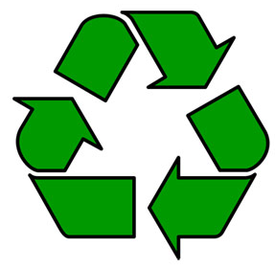
Risk Management
Risk Management
In cloud computing, a effective risk management follows a well-defined information security management processes
  Extendibility
  Reproducibility
The management processes are elasticity when business growth and can be used in difference enterprises.

Slide 24
Management
Risk Management
Enterprises should design the security metric and standard before design the security management
  Everyone needs to understand and record the security metric.
  Enterprises use parts of profits used in security controls.
  Enterprises assess of audit to keep the security requirement.

Slide 25
Enterprise Risk
Risk Management
Companies in cloud computing lose the control of system and security management
  Service level agreement (SLA) is only one to ensure the risk management.
  Enterprise should choose the cloud vendor which can provide the suitable SLA.
Depended on SLA, companies usually cannot test the security management
  Avoid to affect the other user.
  Avoid to affect the QoS of cloud environment.

Slide 26
Information Risk
Risk Management
Information risk management is used for information C.I.A. properties
  Cloud users need to build the SLA requirement and collect necessary information to design the management policy.
  In SaaS, the major security information are provided by cloud vendor.
  In IaaS, users need to collect and control almost all of information.

Slide 27
Third-party Apps
Risk Management
Cloud users need to review the information transfer chain between cloud service and third-party service
  Service relation and dependence.
  Cloud vendor’s third-party application management
  Response mechanism for service interruption
  Third-party application’s extendibility.

Slide 28
Legal
Legal and Electronic Discovery
In cloud computing, data is not controlled by customers
  Instead, cloud vendor hosts all data in cloud environment.
  How to identify the liability is the important things.
A complete cloud law management has three parts
  Functionality
    Definition the cloud service and functionality.
  Judicature
    Legal norms of cloud service and data management.
  Contract
    The structure of contract, terms, conditions and the law enforcement agencies.

Slide 29
Electronic Discovery
Legal and Electronic Discovery
Compared with traditional service
  Cloud computing provides services anywhere and anytime.
  Cloud computing uses virtualization that users unknown the location of the service and data.
  The legal liability may be different in different countries.
Difference countries has difference law norms
  Electronic evidence.
  Record system.
  Management policy.

Slide 30
Suggestions
Legal and Electronic Discovery
Both vendor and customer full understand the roles of law
  Electronic evidence, legal recourse and the expert testimony.
Cloud vendor needs to keep the system secure
  Provides reliability evidences when customers required.
  Recover the data assets when customers terminate the contract.
Cloud security agreement should be review and audit by third-party
  Test QoS and detect the system vulnerabilities.

Slide 31
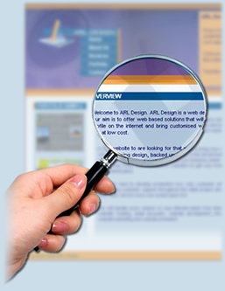
Compliance & Audit
Compliance and audit
In cloud computing, the system separated into several parts
  It is easy to extend, manage and operate.
  It is hard to supervise and audit.
Cloud auditors need to gain rich experience such that
  Supervise the vendor easily and effectively.
  Distinction between liability.

Slide 32
Readiness
Compliance and audit
In cloud computing, companies should prepare well for audit
  Legal department
    Help to review the cloud service contract, supervise the cloud vendor and resolver the legal disputes.
  Right of audit
    Cloud service contract should be changed to satisfy the customer’s requirement.

Slide 33
ILM
Information lifecycle management
The goal of information lifecycle management (ILM)
  Improve the system performance.
  Increate the service functionality.
In cloud computing, data security lifecycle is challenged
  More elasticity
  Multi-tenant
  The new design concept of logic
  Public environment
Cloud users should care about the six phrase of data life

Slide 34
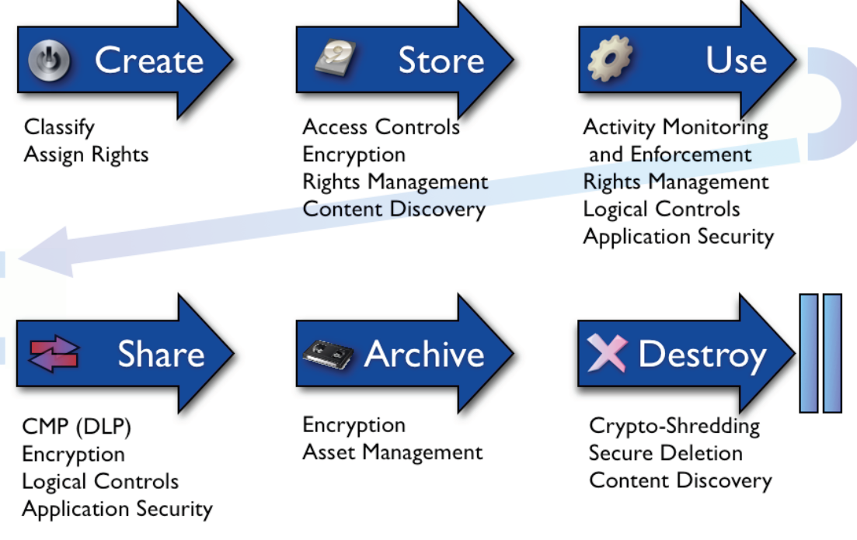
ILM (cont’d)
Information lifecycle management

Slide 35
Suggestion
Information lifecycle management
Cloud customers should understand the full secure process of data
  include storage location, encryption method and management policy.
  should be written in the SLA.
Understand the data could be confiscated
  Cloud vendor need to notify the users.
  Cloud vendor need to protect the data which cannot be modified or damaged.

Slide 36
Suggestion
Information lifecycle management
Only the data owner has the right of access control
  Cloud vendor need to disable all access at the beginning.
  Even cloud vendor’s staff cannot access the data without the permission.
Understand the security boundary
  The encryption system, key management and how to choose the security key.
  The data isolation technique, backup and recover system.

Slide 37
Portability
Portability and interoperability
Cloud computing is the new service model for companies
  Company choose the cloud vendor by cost, service quality, properties and other factors.
Company may migrate from one cloud vendor into another cause by
  New service contract would increate the operating costs.
  Cloud vendor ceases operation or stop providing some services.

Slide 38
Interoperability
Portability and interoperability
Companies need to design the system and secure guideline for particular cloud vendor
  Migrate to another vendor would need to modify the system or re-build the new system.
The difficulty of porting service platform depends on the cloud model
  SaaS usually concerns the data and service platform.
  IaaS needs to consider the underlying system which may be incompatible.

Slide 39
Suggestion
Portability and interoperability
Understand the storage space and the bandwidth of network before migration
  Depending on the other user’s experience, migrate the physical machine usually more effective and less cost.
  Record all the detail when migration.
For IaaS
  Understand the image compatibility before migration.
  Understand the subsequent disposal when hardware are eliminated

Slide 40
Suggestion (cont’d)
Portability and interoperability
For PaaS
  Understand the migration tools what vendor provided.
  Understand the migration affect include performance and QoS.
  Understand how to test and examine the new environment.
For SaaS
  Data duplicate and backup periodically.
  The customized plug-ins should able to be re-build.
  Understand any migration laws and regulations.

Slide 41
Cloud Security Alliance
Governance
Operation

Slide 42
Operation
Users or customers could be encountered the security problem on cloud
  Difference between traditional data center and cloud.
  Security problem on large scale data center.
  Backup and recover policy.
CSA provides many suggestion
  Any kind of secure events occurred when company run the service on the cloud computing environment.
  The secure factors need to be concerned.

Slide 43
Operation (cont’d)
Similar with governance, CSA proposed five class which need to be concerned and CSA given some suggestions
  Traditional security, business continuity and disaster recovery.
  Data center operations
  Incident response, notification and remediation
  Application security
  Encryption and key management
  Identity and access management
  Virtualization

Slide 44
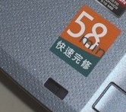
Disaster Recover
Disaster recovery &
Data Center
Similar with traditional data center, cloud computing needs to design the policy of business continuity planning (BCP) and disaster recover(DR)
  Every components in system could be failure.
  The large system is hard to keep the system stability.
  The disaster, like file disaster or earthquake, could damage the cloud infrastructure.

Slide 45
Data Center
Disaster recovery &
Data Center
Service-level agreement (SLA) is part of service contract
  Classify the service and define the delivery time or performance.
Traditional data center usually allocates the fix number of server or resource to customers
  It is easy to overestimate or underestimate.
How to dynamic allocate all resource?
  Reach the SLA requirement.
  Reduce the probability of overestimate

Slide 46
Suggestion
Disaster recovery &
Data Center
Keep in mind: centralized management means concentration risk.
Cloud vendor needs to have a strict management mechanism
  Access control and manage policy.
  Background checks of employees.
  Internal/external security control file.
Cloud customers should be possible to
  On-site investigate the cloud infrastructure.
  View and understand the BCP and DR.

Slide 47
Suggestion (cont’d)
Disaster recovery &
Data Center
Companies need to understand the contract of
  Recovery time
  Recovery object
  Recovery policy
Customers need to gain the right or permission
  Audit the SLA by third-party.
  Understand the process, policy and affect of system patch.

Slide 48
Incident Response
Incident Response
The properties of cloud computing could be hard to manage and response the incident events
  Large scale, shared resource and automated management.
  Cloud vendor needs a standard operation process (SOP) for incident response.
The cloud vendor provides the complexity and large-scale service
  It is hard to monitor the traces and response the incident immediately.
  Each services could cross-impact the management policy.

Slide 49
Views
Incident Response
View for monitor
  We need the security operation center (SOC).
  Each new services and resources should be monitor by SOC.
  SOC provides the notification and guideline for emergency or security events.
View for customer
  Customers need to evaluate the SLA which meets the requirement or not.
  Customers should understand the SOP for incident response.

Slide 50
Suggestion
Incident Response
Before using cloud computing
  Define the normal events and unusual events.
  Test your system which is compatible with cloud environment or not.
SOC is usually used in single or pure environment
  In multi-tenant environment, SOC needs to be modified to monitor data from any source.
  Application layer firewall and log file are helpful on multi-tenant for SOC.
Each sensitive data should be encrypted to reduce the losses.

Slide 51
Application Security
Application Security
In cloud computing
  Cloud vendor provides the environment to users.
  Users run the applications which may be designed by users or third-party.
Similar with normal applications, services in cloud also need to well-design and keep it secure
  Preliminary analysis and confidentiality
  Integrate and availability tests
  Demilitarized Zone

Slide 52
Interoperation
Application Security
Services and applications in cloud interactive frequently
  The dependencies between applications affect the system security.
  Third-party applications also can damage and change the system stability.
  The test tools cloud vendor provided can help system to enhance system security.

Slide 53
Suggestion
Application Security
In the application development lifecycle, we need to concern the three parts
  Security threats and trust model.
  Cloud platform program assessment tool.
  Application’s quality check point.
Keep in mind
  Cannot suppose all communications are in security channel.
The storage and management for application certificate are important.

Slide 54
Encryption
Encryption &
Key Management
How to avoid the data be theft is the important security issue
  Cloud vendor cannot guarantee that sensitive data be in the secure protection.
  The encryption is the efficient way to protect the important data.
In some country, data which is hosted or must be encryption
  Personal information.
  State secure file.
  …etc.

Slide 55
Key management
Encryption &
Key Management
The encryption system can provide the information security for data
  Dependent by the encryption algorithm, e.g. Caesar shift or AES.
  Dependent by the key selection.
  Dependent by the key management.

Slide 56
Management
Encryption &
Key Management
Encrypting and decrypting data costs many resource and time
  Classify the data by sensitive and importance.
  Choose the suitable the encryption algorithm.
In cloud, encryption system is frequency used
  Simple or common password is useless.
  A non-secure key management would damage the encryption system.

Slide 57
Suggestion
Encryption &
Key Management
Cloud customers need to understand the encryption system using in cloud
  Encryption algorithm and costs.
  Key management and Key generation policy.
Customers need to specify the encryption service in SLA
  The encryption system should be audited by third-party.
  Limitation for length and strength of key is required.

Slide 58
Access Control
Access
Management
After keeping data in security environment and encryption, we need to understand the access control policy
  Guest can accessed the sensitive data is dangerous.
In cloud computing, number of users is larger beyond our imagination
  Complex of access control policy
  Add / delete user’s access right immediately.
  Identify and authorize the user.

Slide 59
IAM
Access
Management
The identify and access management (IAM) system in cloud should be fair and rigorous assessed
  Identity provision
  Authentication
  Union management
  Authorization and user configuration
Customers can use the third-party authorization
  OpenID, Google or Facebook
Cloud vendor need to provide the (single sign-on) SSO
  Avoid the repeated login

Slide 60
Virtualization
Virtualization
In cloud, virtualization technique is widely used
  Abstract and integrate the resource.
  Easily to provide the on-demand resource to users.
Virtualized resource means mix all resource
  Concentration of risk.
  Each user must meet the secure requirement.
Hypervisor monitor and communicate with virtualization machine (VM)
  Break the hypervisor could break all system.
  Attacking to hypervisor is the new malicious methods.

Slide 61
Suggestion
Virtualization
Understand the virtualization technique used in cloud environment
  The security and isolation of hypervisor.
  The default configure and setting must be secure.
  The resource image of VM must be tested and verified.
The hypervisor owns the high secure permission
  Only few staff and users has the right to access the hypervisor.
  Each access to hypervisor must be recorded.

Slide 62
Summary
Cloud security alliance (CSA) provides the security guidance and separate cloud security
  Two field: governance and operation.
  Twelve sub-categories.
Each sub-categories introduce the problem could occurred and given some suggestions.
In three service model, CSA provides the general views and give difference suggestions for difference model.

Slide 63
Law and Privacy

Slide 64

The Real World
Like the real world, criminals are around of us and we can be the victim anytime and anywhere
  In the computer would, crackers hide in the network and try to attack anything interesting.
  Lawless employees also try to sale the sensitive and important data.
Law is the last line of defense.

Slide 65
Enforcement
Users try to believe the performance and protection what company claim
  But lots of security incidents are frequency appeared in the news.
    In 2011, Dropbox claims all data in server are encrypted, but…
  User are beginning to doubt the company’s guarantee.
Law can provide the basic protection
  Company needs to provide the basic security protection and basic quality of service.
  Also, law resolves the dispute between user and company.

Slide 66
Online Shopping
It is popular and convenient to purchase on the internet
  People can buy books, foods, and the car on the web.
  People could not see the product until receive the product.
There are many problems on online shopping
  There are some difference between image and product.
  It may be some mistake on the price.
  The personal information could be hijacked or therft.

Slide 67
Security Protection
On the customers view
  All personal data must be under the full protection.
  Everything must be meet the description of the product.
On the companies view
  Security protection is not just the responsibility of the company.
But world is not all liking wishful!

Slide 68

Privacy
On the other hand, the privacy is the basic personal right
  No one shall be subjected to arbitrary interference.
  Everyone has the right to the protection of the law against such interference or attacks.
The privacy includes
  Personal information.
  Religion and sexual orientation.

Slide 69
Net Generation
Now is the net generation
  Every teenager is living in internet.
  Everyone can find lots of interesting information in internet.
    Phone number, intimate photos or contents of email.
Users need someone to protect the privacy
  The law and government can provides the basic and strong protection.
  But in sometime, the law is also broken the right of privacy.

Slide 70
Law and privacy
Information Protection
USA PATRIOT Act

Slide 71
Personal Information
Everyone in the internet would leave some traces
  User leaves the personal information to apply for Google and Facebook account.
  User leaves the name, phone number and address to buy something.
This information can be used on some malicious behavior
  Fake identity.
  Internet fraud

Slide 72
Law of Personal Information
In 2010, Taiwan government enact laws to protect the personal information
  It specifies the limitation of personal information collection, process and usage.
  Companies need to provide the evidence actively to exclude the liability.

Slide 73
Clause
There are many clauses to specify the usage of personal information and the penalty of breaking the law
  Everyone can apply for compensation top to twenty thousand when personal information has been violated.
  When a crime occurs, companies need to provide the evidence that they has been meet the requirement of the law.

Slide 74

Company Risk
From the probability point of view
  Each company may lose the sensitive information.
  Cloud company has lots personal information.
  If company lost 1/20 data (e.g. Five thousand data)
    Fines would be up to one million NT dollars.
  Also, company lose his corporate image.

Slide 75
Traces
Companies are invested in the preservation of evidence to avoid penalties of laws
  Companies try to keep traces and logs which records all operations.
The record system must be stable and reliable
  But there are few guideline used for record system.
  Company also need to modify all system to interact with record system.
    It would be complex, massive and expansive.

Slide 76

When Crime Occurred
The traces is the first solution used to identify the attribution of responsibility
  Traces must be clean and cannot be modified.
  The method of keeping trace also need to be trusted.
But unlike the fingerprint or DNA, electronic evidences are easier to modify or fake
  Keeping the isolation between traces and system is important.

Slide 77
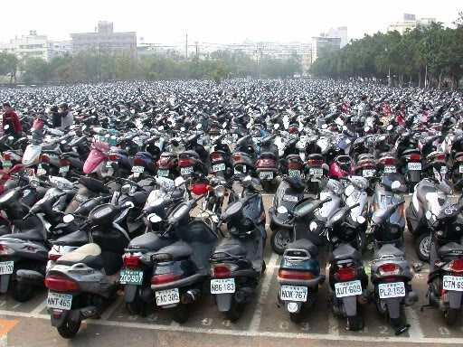
In Cloud
In cloud computing
  Traces would growth into a massive and large size such that finding the crime evidence is difficult.
  The large size of traces means the difficult of keep record stable and reliable.
How to duplicate, isolate and manage the traces?
  Replica and off-site backup.
  Automation and systematization.
  Reduce human intervention.

Slide 78
Law and privacy
Information Protection
USA PATRIOT Act

Slide 79
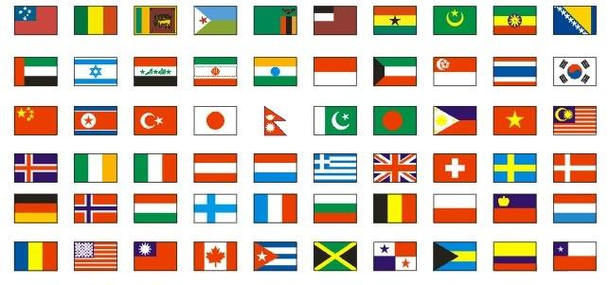
Outside the Law
In a special case, law may be outside the country
  One user in A country would be under the law of B country.
Cloud provides service to anywhere on the world
  Server and user are usually located at the difference country.
  Have Foreign country the right to access the user data?

Slide 80
USA Patriot Act
One of the most important news in cloud computing is USA patriot act
  U.S. government has the right to access all of data in the U.S. country.
  Also, U.S. government has the right to access the data which is hosted by U.S. companies no matter what the data at USA or at foreign country.
Microsoft and Google recognized to provide the data to the U.S. intelligence
  The data are located on the server in Europe.

Slide 81
USA Patriot Act (cont’d)
User
Data
U.S. Company
Replicate or Remote backup
U.S. Server
Europe Server
U.S. intelligence
Law enforcement

Slide 82
Affect
Users mistrust the cloud service
  User data could be access without any permission.
  User cannot keep secret in the internet.
Lots of important institution are limited to use the cloud service
  The sensitive data, important service and technique cannot be hosted on the cloud companies.
  If necessary, all data must be encrypted and independent stores the key.

Slide 83
Summary
Cloud computing is the new industry
  The laws grow up slower than cloud computing service.
  The old provision cannot meet the companies’ or customers’ requirement.
  The new provision still not well-develop.
Depending the properties of cloud
  Cloud computing service cannot avoid the need to provide cross-country service.
  There may have some conflict between local laws and foreign laws.

Slide 84
Summary (cont’d)
The privacy is the popular issue for cloud security issue
  Cloud services is growing rapidly and around of our life.
  Cloud vendors and companies own lots of customers private information and data.
The law is used to protect our right
  When government needs to protect the most people, the privacy of small number of people will be violated.
  Who wants to be a small part of the victims?

Slide 85
Reference
Cloud Security Alliance (CSA) https://cloudsecurityalliance.org/
News
  http://www.zdnet.com.tw/news/software/0,2000085678,20126532,00.htm
  http://www.informationsecurity.com.tw/article/article_detail.aspx?tv=11&aid=6286
  http://law.moj.gov.tw/LawClass/LawAll.aspx?PCode=I0050021
All resources of the materials and pictures were partially retrieved from the Internet

